Slide 1
May 2018
Cisco Meraki Brainstorm K20 - March 2019
Presented by: Jose Valdez & Matthew Pelkey
Session Code: 361NA
Notes:
Welcome!
Introduce yourself
What am I going to talk about?
Who are we, what do we do and how can we help you?
How Cisco Meraki can help you extend and secure the network
A few quick use cases for SLED & commercial / enterprise
Troubleshooting / assurance demo
End-to-end troubleshooting
Wireless Health
Meraki Insight
Quick show of hands
Who’s heard of Cisco Meraki?
Who’s used one of our products?

Slide 2
Agenda
30 min | Welcome, Meraki and Cloud Managed Networking Overview
30 min | Meraki Product Overview and Feature Highlights
30-60 min | Dashboard Demos with Q&A
1-2 Hours | LAB 1 | Small / Medium Site (Initial Setup, Group Policies, Auto VPN, Wireless)
1 Hour | LAB 2 | Large Site / Campus (L3 Routing, Authentication and Security)
1 Hour | LAB 3 | Distributed Enterprise (Advanced Auto VPN, DC Redundancy, SD-WAN)
1-2 Hours | LAB 4 | Meraki Dashboard API (If applicable and / or made available by instructor)
NOTE: To skip to Labs 2, 3 or 4, you still need to complete the addressing section in Lab 1: Section 1.1.1 (Initial MX Setup)

Slide 3
mer·a·ki noun [Greek]
The soul, creativity or love put into something; the essence of yourself that is put into your work.
Notes:
What does Meraki mean?

Slide 4
Simplifying powerful technology to free
passionate people to focus on their mission
WORK SIMPLE
Notes:
That soul, creativity & love is then poured into our mission, which is simplifying powerful….
Technology has gotten more complicated
The day of network programmability is upon us
We put so much time and energy into ‘keeping the lights on’ so to speak
Are we putting enough effort into proactive planning?
Are we taking enough time for professional development and developing our skills?
Our passion / mission is ultimately about:
Reducing the barrier to entry for powerful, expert-level IT
Giving our customers time back to focus on higher-value, more strategic tasks
Who hates hearing that ‘IT is a cost center’?
Our mission is to help you transform IT into a strategic enabler of the business / mission of your organization

Slide 5
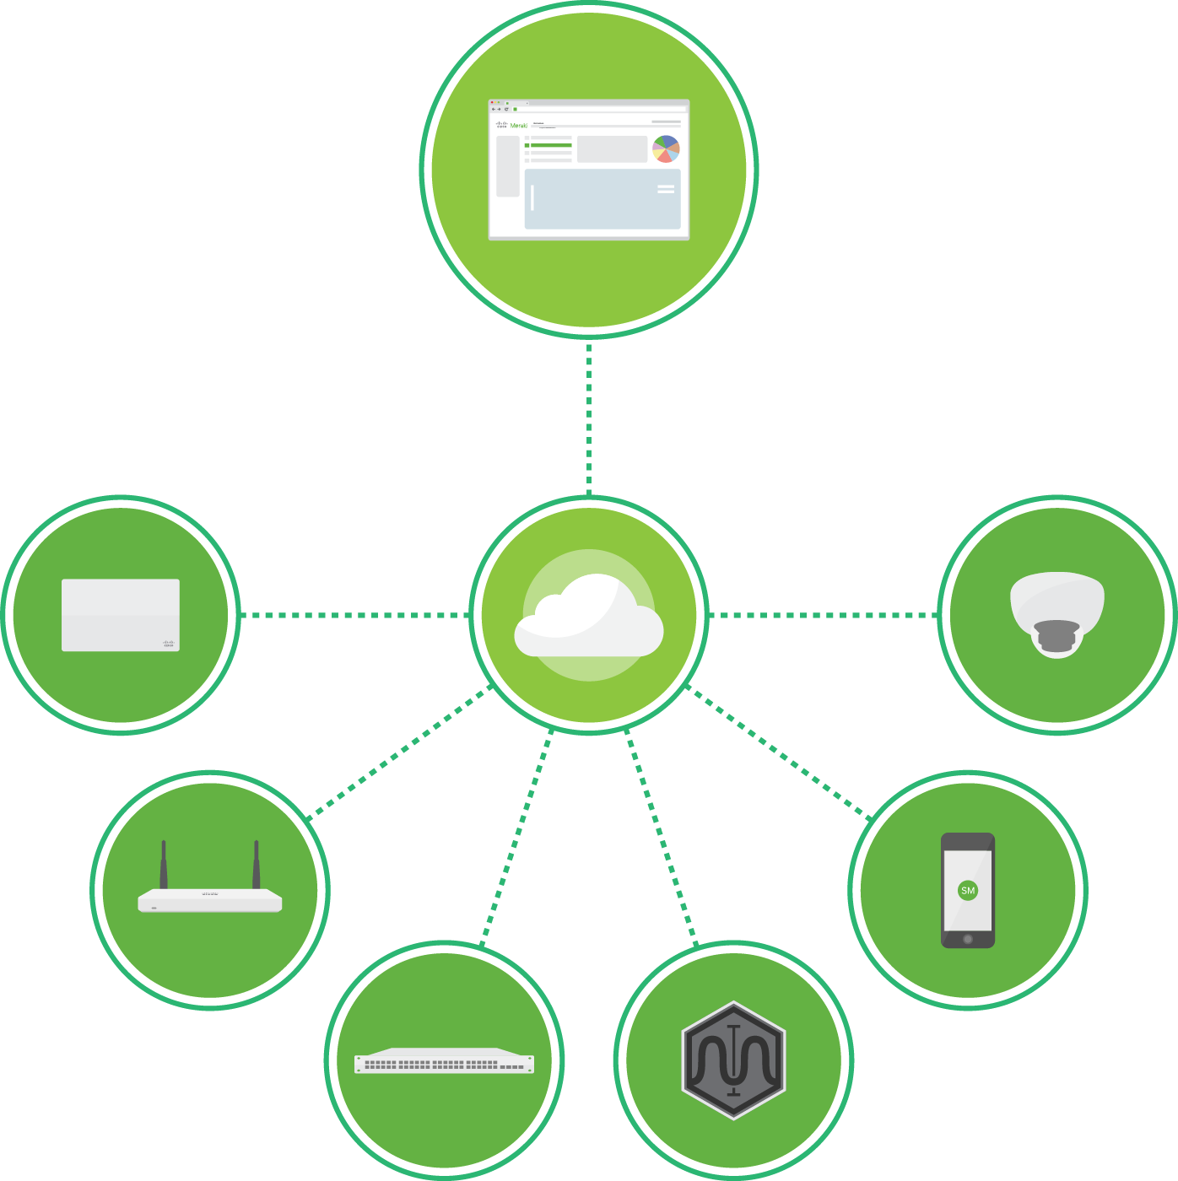
Simplifying IT with Cloud Management
A complete cloud-managed IT solution
Wireless, switching, security, SD-WAN, endpoint management, insight, and security cameras
Integrated hardware, software, and cloud services
Leader in cloud-managed IT
Among Cisco’s fastest growing portfolios
250k+
Unique customers
3.5M+
Meraki devices
online
5.5M+
Active Meraki
dashboard users
Notes:
How do we do that?
The Meraki Dashboard is the single pane of glass that enables you to manage your entire network from anywhere in the world
If you’ve used one of our products, you’ll be able to use them all

Slide 6
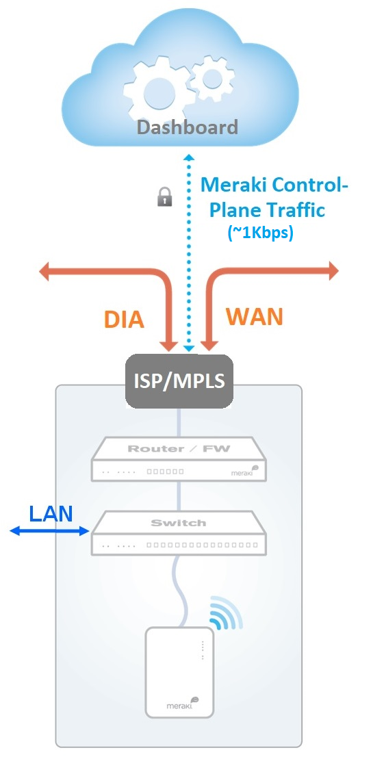
Benefits of a cloud-based solution
Simple
- Turnkey 0-touch deployments, intuitive, anywhere/anytime access
Scalable
- From small branch to large enterprise, unlimited throughput and scale
Reliable
- Highly available cloud architecture, multiple worldwide data centers
- Network runs even if cloud becomes unreachable, 99.99% SLA
Secure
- No user traffic traverses cloud, Fully HIPAA and PCI Level 1 compliant
- Regular 3rd party auditing and daily penetration testing
Future-proof
- Automatic (user controlled) firmware updates & consistency
Lowest Total Cost of Ownership
- Lowest OpEx: rapid deployment, simple config & mgmt, easy troubleshooting
Additional Security and Reliability Info: meraki.cisco.com/trust

Slide 7
Simple, All-inclusive Licensing
A Meraki solution includes a 1:1 ratio of hardware and licenses
Licensing is required and includes:
Centralized management and network-wide visibility and control
Seamless firmware and security updates
24/7 Enterprise Support
NBD advance hardware replacement
Lifetime warranty*
*Some exceptions such as outdoor APs (1 year) and cameras (3 years)
+
hardware
license
The HW + cloud license represents the total cost of ownership for all of your Meraki devices

Slide 8
Meraki MX – Security Appliances

Slide 9
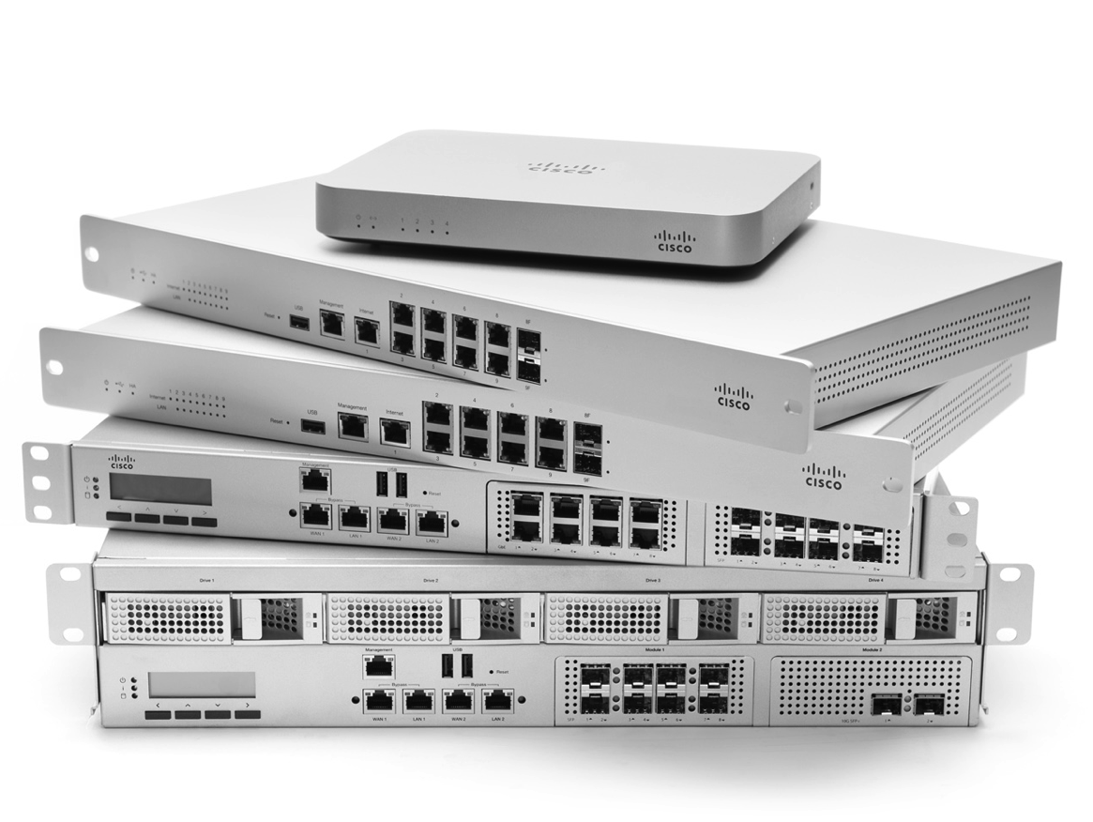
MX security appliance
Feature highlights
Security NG Firewall, Client VPN, Site to Site VPN, IDS/IPS, Anti-Malware (AMP)
Networking NAT/DHCP, SD-WAN, 3G/4G Cellular, Link Balancing
Application Control Traffic Shaping, Content Filtering, Geo Firewall Rules
A complete unified threat management and SD-WAN solution
16 models (14 physical, 2 virtual) scaling from teleworker and small branch to campus / datacenter

Slide 10
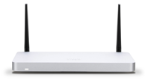
Web search “MX Sizing Guide”
Meraki Security & SD-WAN Portfolio
Teleworker
Small Branch
New
New
New
Z3
Z3C
MX64/65
MX67/68
MX67C/68CW
5 users
802.11ac Wave 2 Wireless & PoE
FW throughput: 100 Mbps
CAT 3 LTE (Z3C)
~50 users
802.11ac Wireless* & PoE
FW throughput: 250 Mbps
~50 users
802.11ac Wave 2* & PoE
FW throughput: 450 Mbps
~50 users
802.11ac Wave 2* & PoE
FW throughput: 450 Mbps
CAT 6 LTE
Medium Branch
Large Branch, Campus or Concentrator
Virtual
MX84
MX100
MX250
MX450
vMX100 for AWS & Azure
~200 users
FW throughput: 500 Mbps
~500 users
FW throughput: 750 Mbps
~2,000 users
FW throughput: 4 Gbps
~10,00 users
FW throughput: 6 Gbps
FW: 750 Mbps
VPN & SD-WAN features
*Available with wireless models
(MX64W, MX65W, MX67W, MX68W, MX68CW)

Slide 11
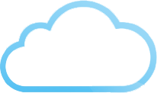
MX Licensing that fits the business’ needs
Enterprise License
Advanced Security License
Stateful firewall
Site-to-site VPN
SD-WAN
High availability failover
Application control
Traffic shaping
Client VPN
All enterprise features, plus
Content filtering (with Google SafeSearch)
Cisco AMP for Malware protection
Sourcefire IDS/IPS
Threat Grid integration*
Geo-based firewall rules
*additional Threat Grid subscription required

Slide 12
SD-WAN functionality for the branch
Available on all MX platforms
Dual-Active Path:
Active-Active VPN
Dynamic Path Selection:
Performance-based routing ensures the best uplink is used based on latency and loss metrics
Policy-based routing:
Allows uplinks to be intelligently assigned based on traffic protocol, subnet, source, destination, etc.
WAN 1
Secure VPN tunnel (active)
Latency / loss > threshold
WAN 2
Secure VPN tunnel (active)
Latency / loss < threshold
Based on L3 / L4 categorization, this data normally travels out WAN 1 (PbR), but MX detects optimal path is WAN 2 based on latency / loss on WAN 1 (PfR).
Data
Notes:
Dual-active path: Active-active VPN
Dynamic Path Selection
Ensures the best uplink is used based on latency and loss metrics
Policy-based routing (PbR):
Allows uplinks to be intelligently assigned based on traffic protocol, subnet, source, destination, etc.

Slide 13
Cisco SourceFire AMP
AMP Cloud
Advanced Malware Protection with Retrospection and ThreatGrid Integration
Disposition lookup
Internet
AMP Connector
AMP TG Connector
AMP Threat Grid
File Sandbox

Slide 14
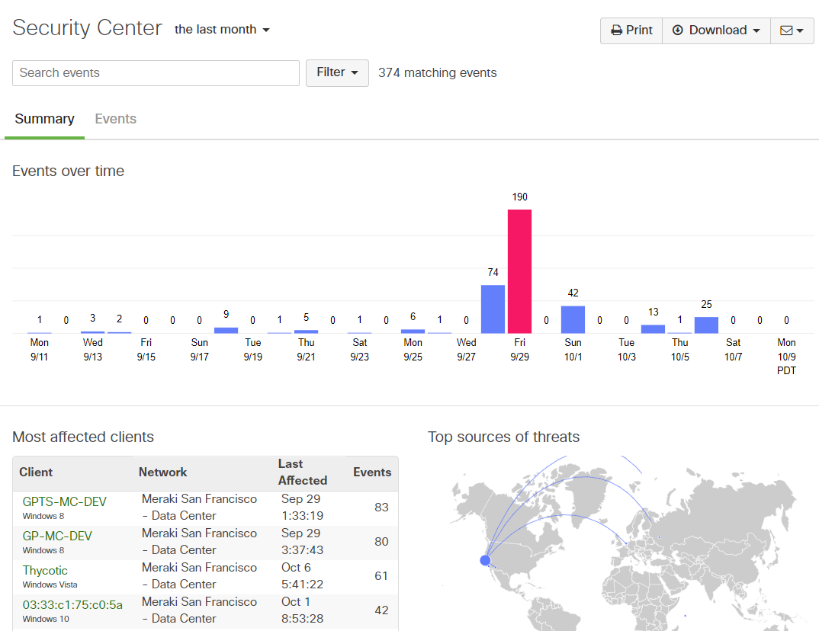
Dashboard Security Center (replaces Security Reports)
All security-related events and summary report in one place
Pivot on the client, network, threat or remote source of an incident
Quickly identify clients and networks that are potentially infected
Identify threats that appear across multiple networks
See most affected clients and most prevalent threats
Drill down into rule details and signatures and CVE info
NEW: Anomaly Detection

Slide 15
Meraki MS – Switching

Slide 16
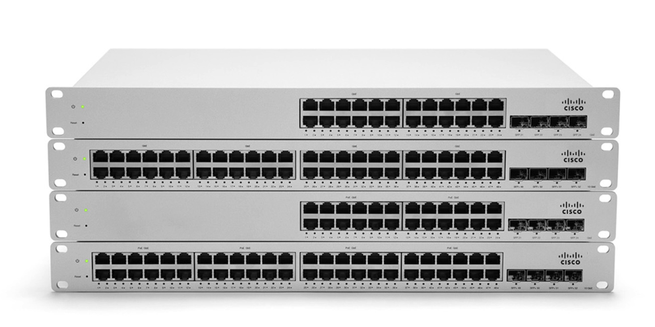
MS switches
Feature highlights
Voice and video QoS
Layer 7 app visibility
Virtual and physical stacking
Dynamic routing
Enterprise security
Remote packet capture, cable testing
Topology view
37 models ranging from compact and closet access switches to campus fiber aggregation switches
Introducing cloud managed physical stacking, multigigabit performance, UPoE to the campus network

Slide 17
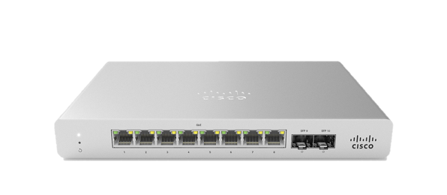
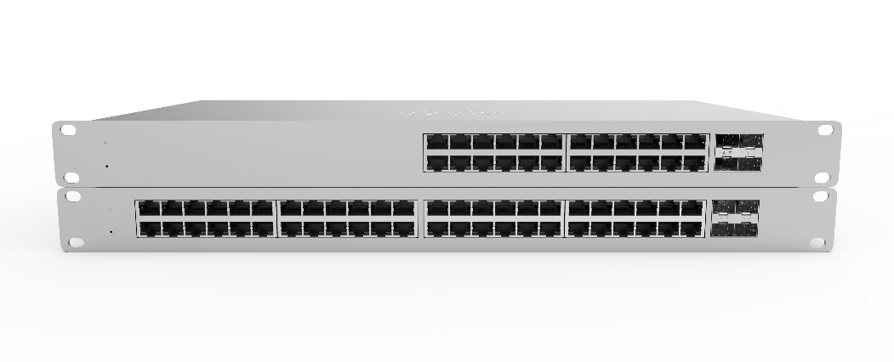
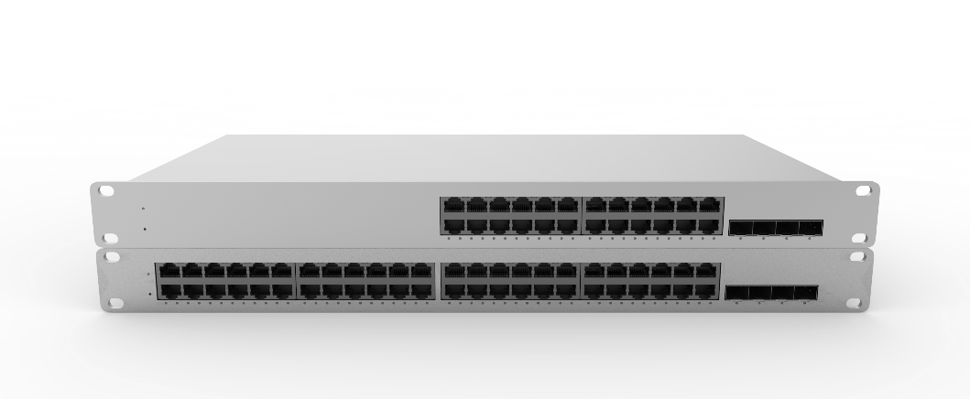
Meraki Layer 2 Access Switching
Compact
Branch
Branch & Campus
Branch & Campus
MS120-8
PoE+
options
1G SFP
Uplinks
Slim Form Factor
MS120
PoE+
options
1G SFP
Uplinks
L2⁺
MS210
PoE+
options
1G SFP
Uplinks
80G
Stacking
L3 Static
Routing
RPS
Optional
Compatible Stacking
L2⁺
MS225
PoE+
options
10G SFP+
Uplinks
80G
Stacking
L3 Static
Routing
RPS
Optional
Notes:
Add mgig

Slide 18
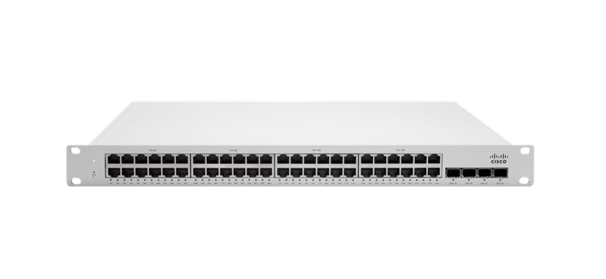
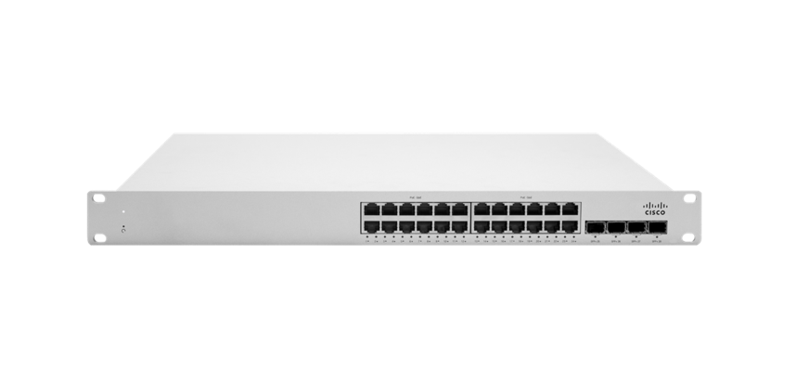
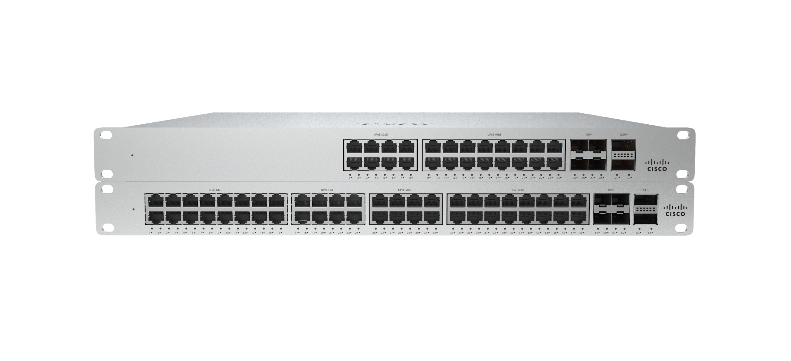
Meraki Layer 3 Access Switching
Branch & Campus
Campus
Campus
High Bandwidth Campus
L3⁺
MS250
PoE+
options
10G SFP+
Uplinks
80G
Stacking
Layer 3
Routing
Modular
Power
L3⁺
MS350
PoE+
options
10G SFP+
Uplinks
160G
Stacking
Highly
Scalable
L3 Routing
Modular
Power
Modular
Fans
Compatible Stacking
L3⁺
MS350-24X
Highly
Scalable
L3 Routing
PoE+/UPoE
10G SFP+
Uplinks
160G
Stacking
Modular
Power
Modular
Fans
Multigigabit
L3⁺
MS355
Highly
Scalable
L3 Routing
Modular
Power
PoE+/UPoE
10G/40G
Uplinks
400 G
Stacking
Modular
Fans
Multigigabit
Notes:
Add mgig

Slide 19
Meraki Layer 2/3 Aggregation
Small & Medium Campus
Medium & Large Campus
Medium & Large Campus
L3⁺
MS410
1G SFP
links
10G SFP+
Uplinks
160G
Stacking
Highly
Scalable
L3 Routing
Modular
Power
Modular
Fans
L3⁺
MS425
10G SFP+
links
40G QSFP+
Uplinks
160G
Flexible
Stacking
Highly
Scalable
L3 Routing
Deeper
Buffer
Modular
Power
Modular
Fans
L3⁺
MS450
40G QSFP+
links
100G QSFP28
Uplinks
400G
Flexible
Stacking
Highly
Scalable
L3 Routing
Deeper
Buffer
Modular
Power
Modular
Fans
Notes:
*Mgig is available for 350-24X

Slide 20
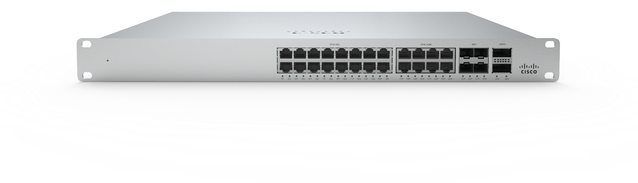
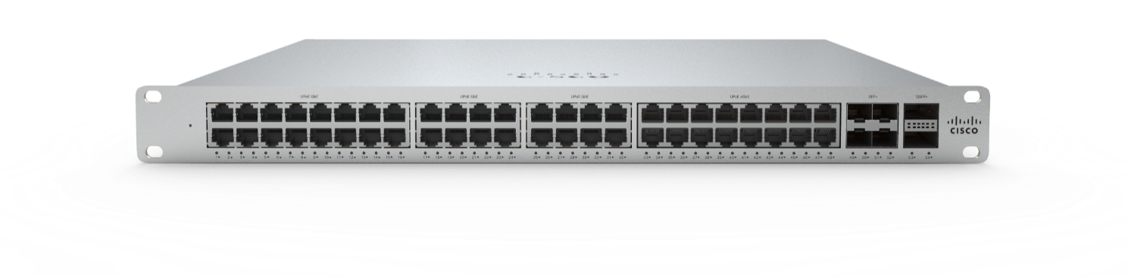
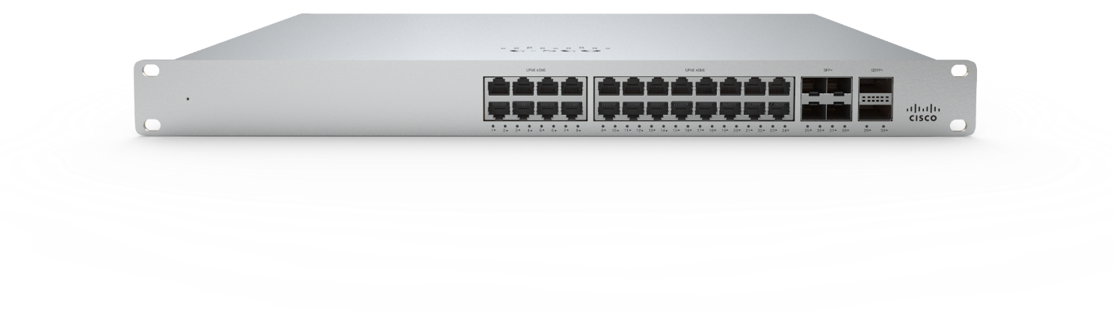
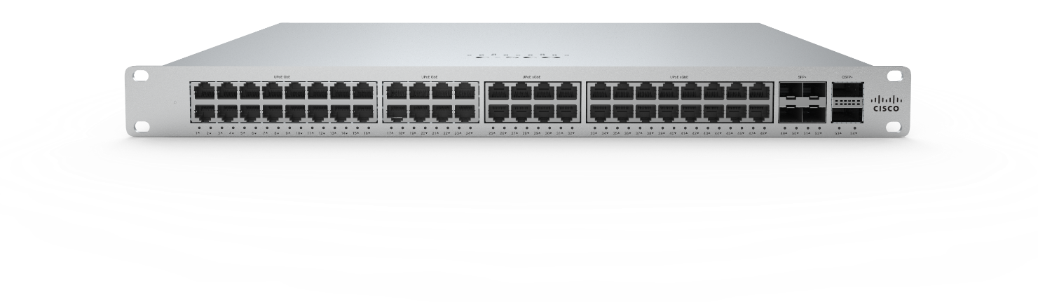
Prepare for 802.11AX with Meraki MS355 Switches Higher mGig Port Density Stackable Access Switches
MS355-24X
8 x mGig
16 x 1G
4 x 10G, 2 x 40G
MS355-48X
16 x mGig
32 x 1G
4 x 10G, 2 x 40G
MS355-24X2
24 x mGig
4 x 10G, 2 x 40G
MS355-48X2
24 x mGig
24 x 1G
4 x 10G, 2 x 40G
High mGig port-count for larger deployments of AX access points
Available in 24- and 48- port models
2 x 40G QSFP+ or 4 x 10G SFP+ uplinks
400G of stacking bandwidth
Dynamic Layer 3 routing
PoE+/UPoE support
Gig
mGig
10G
40G

Slide 21
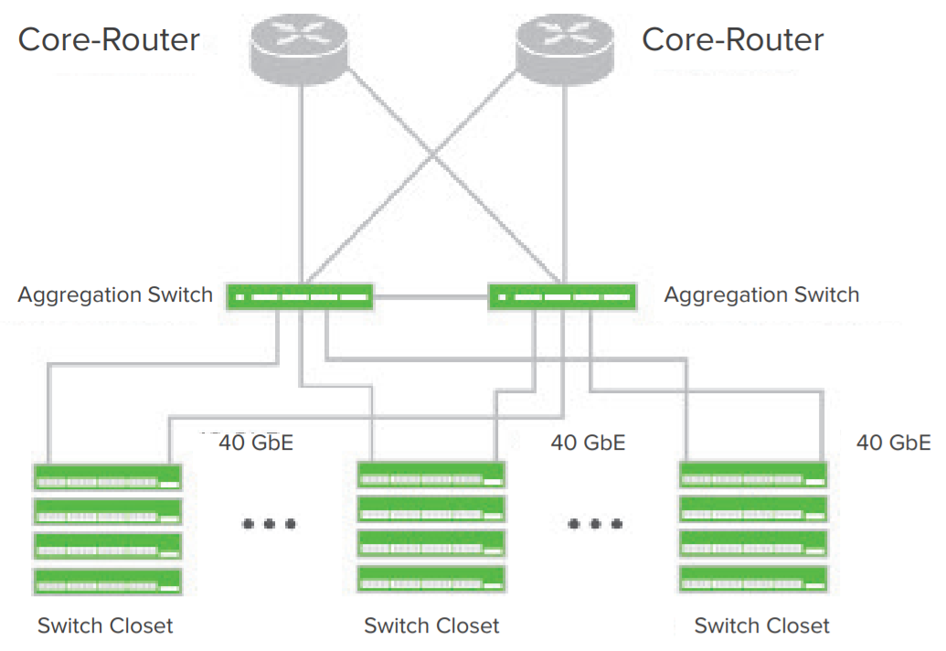
Meraki MS450 Aggregation Switches 40G fiber aggregation switch with 100G uplinks, designed for data-intense networks
MS450-12
12 x 40G interfaces for aggregation switching
2 x 100G QSFP28 uplink interfaces
2 x 100G QSFP28 stacking interfaces, 400G stack bandwidth
Physically stack up to 8 switches for HA deployments
Non-blocking backplane architecture, 1.36Tbps capacity
Field replaceable, redundant power supplies & fans
Front-to-back cooling, shallow rack depth 19”
Lifetime hardware warranty
Data Sheet: https://meraki.cisco.com/lib/pdf/meraki_datasheet_ms450.pdf

Slide 22
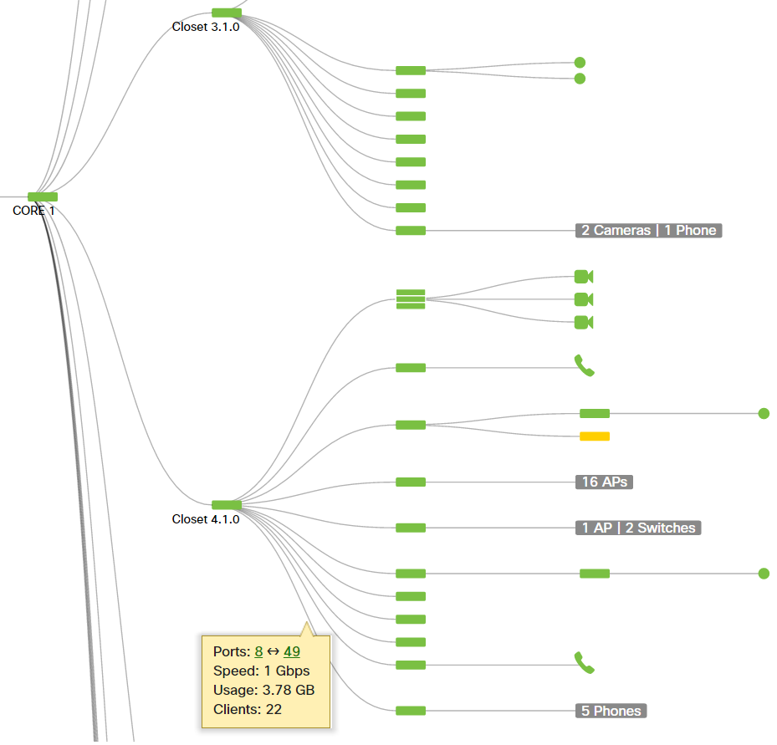
Network Topology: Live end-to-end network visibility
Dynamic discovery
CDP/LLDP provides end to end discovery including placement of non-Meraki devices.
Intelligent updates
Hands free, live view of current network topology with instant view of online, offline, alerting devices.
Seamless network navigation
See statistics and connectivity information with clickable live links into devices/ports.
Customizable
Collapse or expand to any number of levels or specific sections of the graph as needed.
Searchable
Search by name, tag, device type, MAC address.
Exportable
Downloadable as an SVG.

Slide 23
Meraki MR – Wireless

Slide 24
MR wireless access points
Feature highlights
BYOD policies
Application firewall & traffic shaping
Guest access
Enterprise security
Full-time WIDS / WIPS
Location analytics
Bluetooth Low Energy
RF Profiles
Wireless Health
Lifetime warranty on indoor APs
11 models including indoor / outdoor, value-priced, high performance
802.11ac Wave 2, multigigabit performance, and dedicated scanning and BLE radios

Slide 25
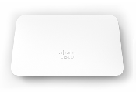
Meraki MR Wireless Access Point Models
General Purpose
High Performance
Hospitality
Entry Level
Future Proof
Indoor
MR30H
2 Stream, 4-Radio
802.11ac Wave 2
80MHz Channels
Integrated 4-port switch
1 PoE-out port
MR20
2 Stream, 2-Radio
802.11ac Wave 2
80MHz Channels
MR33
2 Stream, 4-Radio
802.11ac Wave 2
80MHz Channels
MR42
3 Stream, 4-Radio
802.11ac Wave 2
80MHz Channels
MR42E
3 Stream, 4-Radio
802.11ac Wave 2
External Antennas
80MHz Channels
MR52
MR53
4 Stream, 4-Radio
802.11ac Wave 2
160MHz Channels
Multigigabit (MR53)
MR53E
4 Stream, 4-Radio
802.11ac Wave 2
160MHz Channels
Multigigabit
External Antennas
Outdoor
MR70
2 Stream, 2-Radio
802.11ac Wave 2
80MHz Channels
MR74
2 Stream, 4-Radio
802.11ac Wave 2
80MHz Channels
MR84
4 Stream, 4-Radio
802.11ac Wave 2
160MHz Channels
Multigigabit
4-Radio = 2.4GHz client serving radio, 5GHz client serving radio, Scanning radio, BLE radio

Slide 26
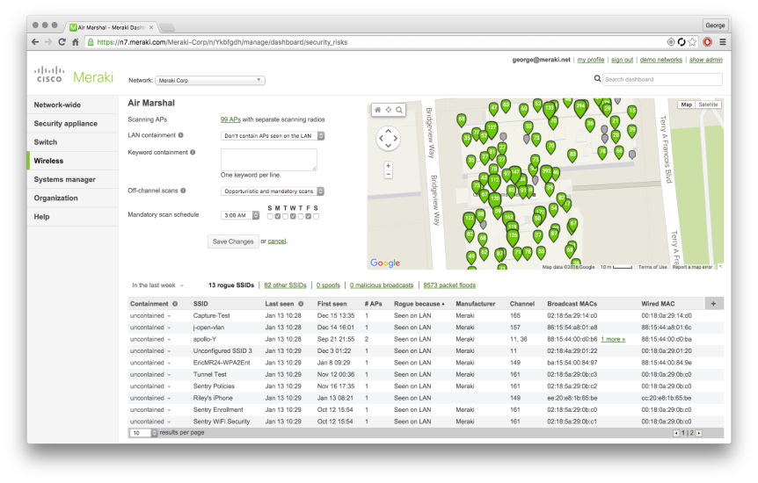
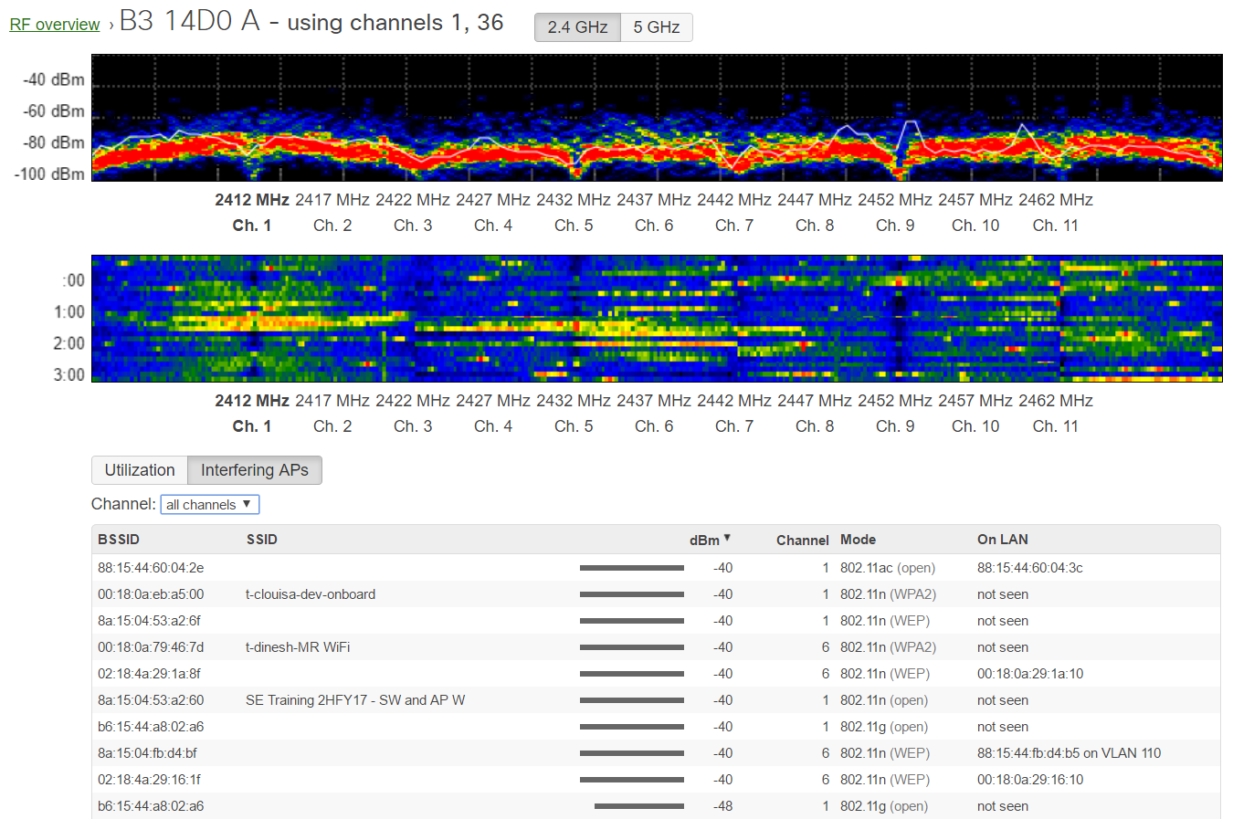
MR Scanning Radio Tames Hostile RF Environments
Air Marshal
Full-time WIDS / WIPS scanning
User-defined attack policies
Updated signatures pushed from the cloud
Gain insight on nearby SSIDs/rogues
Auto RF
Intelligently spread channel & power across all APs
Reduce client stickiness and overcrowded APs
Meraki Dashboard
Classify and filter attacks
Take down rogue APs
View forensic data
Meraki
802.11 APs
Rogue SSIDs
Other SSIDs
Malicious
broadcasts
Packet
floods

Slide 27
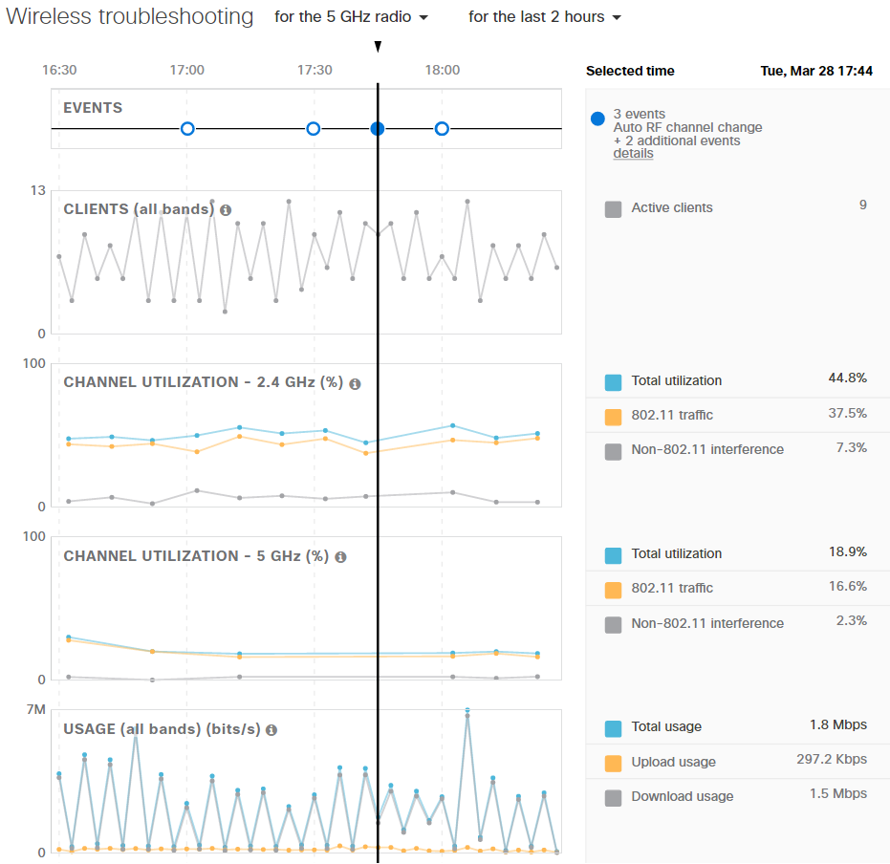
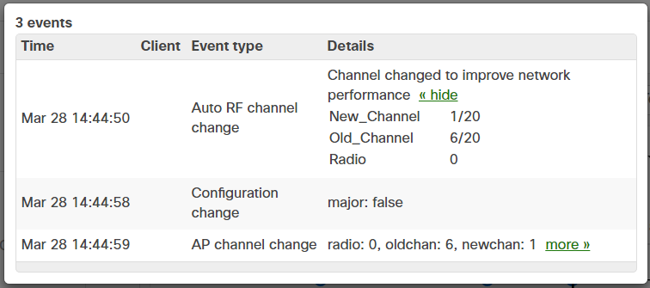
RF Troubleshooting with Retrospection
In addition to real-time spectrum analysis and channel utilization on both bands, Dashboard also provides historical RF troubleshooting.
Easily see how many clients were associated to any access point at any time, what the channel utilizations (and interference levels) were on each band, as well as overall utilization for the AP.
Blue circles across the top indicate “events” for when the AP changes channels or adjusts transmit power for example to improve performance.

Slide 28
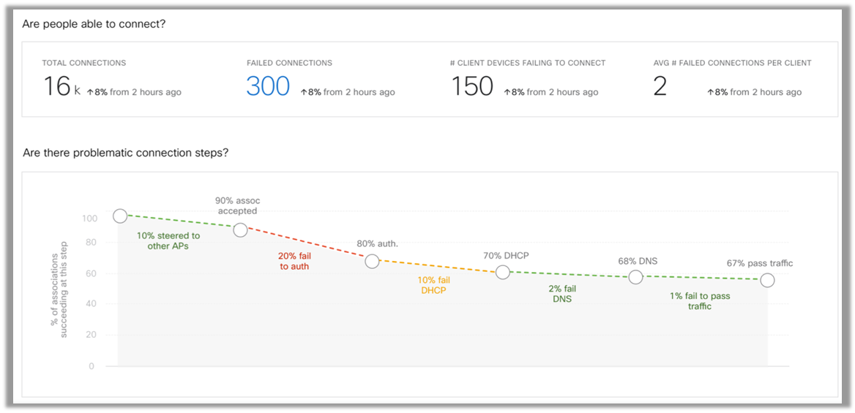
Wireless Health
Another step towards more proactive, intelligent wireless networking, Wireless Health enables customers to better answer the question of whether end users are able to access the wireless network as expected… and if not, where the issues are.
“A few hours ago, 120,000 Meraki customers with over 3 million APs woke up and had Wireless Health at no additional cost and without updating a single AP or controller or server.”
Simplify optimization of wireless networks by automatically isolating issues in the steps to successful wireless access: AP association, network authentication, IP address allocation, and DNS hostname resolution.
Metrics and anomaly detection for client network association and authentication times, wireless connection quality (latency), capacity (data rate) and more.

Slide 29
Cisco Umbrella Integration with MR
90% of malware leverages DNS as some point in the attack process.
Meraki and Umbrella dashboards can be linked via API keys.
This allows MR wireless clients to have DNS traffic filtered through Umbrella’s DNS service.
Umbrella DNS filtering can apply on a per-SSID basis or to wireless clients assigned to network wide group policies.
Simply assign a filtering policy to an SSID or GP, and all DNS requests are redirected to Umbrella and checked against the network device policy in the Umbrella dashboard.
New in MR26.x
Secure WiFi
Dashboard Linkage
Policy Flexibility
Define Umbrella policies to protect corporate users, guest wifi and BYOD
Link Meraki Dashboard directly to the Umbrella account via API
Assign Umbrella policies to Meraki wireless networks, per-SSID or Meraki Group Policy
MR + Umbrella Benefits:
Per-client filtering using group policies, with reporting.
No need for an appliance on site.
Flexibility of filtering users no matter where the AP is deployed.
All in one cloud experience providing CIPA level filtering / protection

Slide 30
Meraki MV – Meraki Vision

Slide 31
Meraki MV Security Cameras
Security cameras that do more than just security
The only security camera from a cloud leader
Fully managed via the Meraki dashboard – No NVR, no software, no video management system, no browser plug-ins. Just the camera and a license.
Up to 256GB high-endurance solid state local storage: On-board mini-DVR on each camera.
Motion-based retention and schedule-based retention
High-end processors for advanced analytics such as object (people) detection & counting
Cameras act as sensors, not just security cameras, analytics processed locally, motion indexed in the cloud

Slide 32
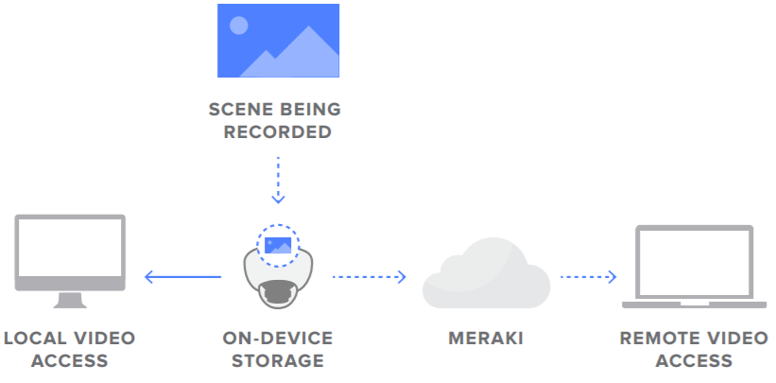
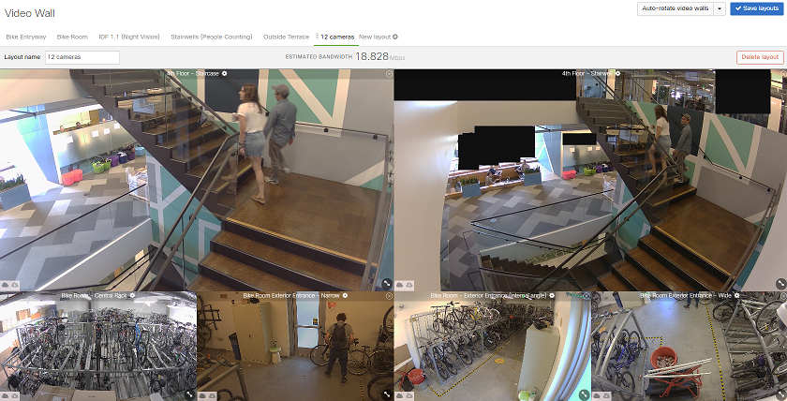
Optimized Edge architecture
Bandwidth conscious
Local on-board storage, only a few Kbps of data placed onto the IP network per camera
Reduced Complexity
Eliminates DVR/NVR requirement, reducing equipment costs, maintenance, single points of failure
Scheduling & Privacy Features
Set recording schedules, create configuration templates, and/or set up privacy windows for areas that should not be recorded
Video Walls
Create and fully customize video walls as needed in a simple and intuitive fashion with automatic bandwidth optimization, auto-rotation, full motion search capabilities
Notes:
Cloud: centralized control, management, config, metadata (thumbnails and motion indexing) – no video
Cloud where cloud makes sense: high quantity of cameras, compliancy issues
Video stored local: eliminates need for NVR and software, reduce OPEX/CAPEX
Dashboard advantages: 2 factor authentication, local time zone, firmware upgrades, enabled alerts (health status, reason for fault)
Local vs. proxy: if determined IP route exists, delivered without traversing WAN/Internet

Slide 33
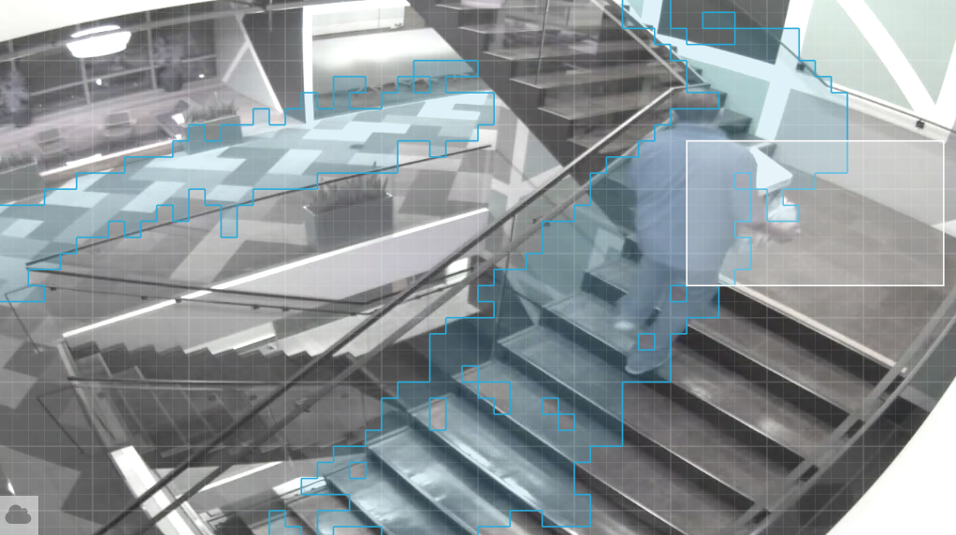
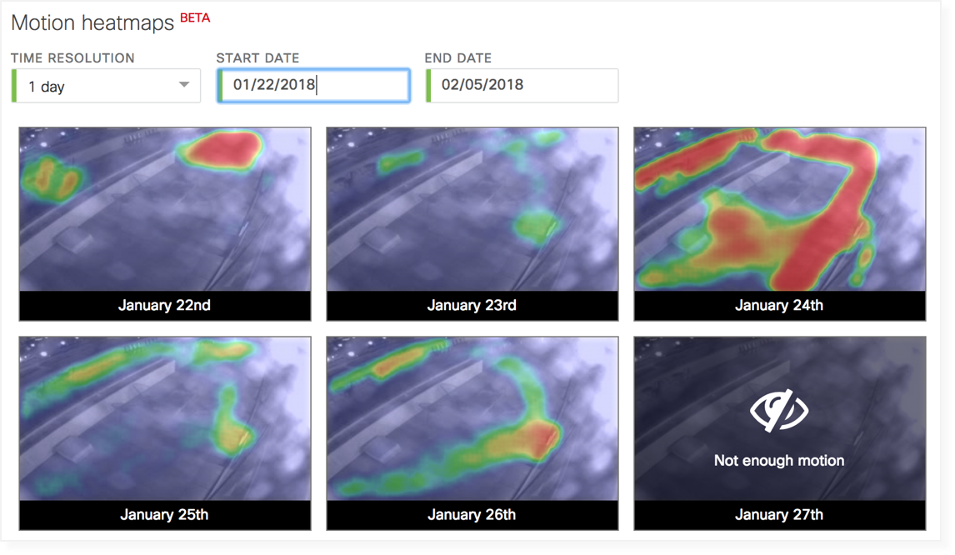
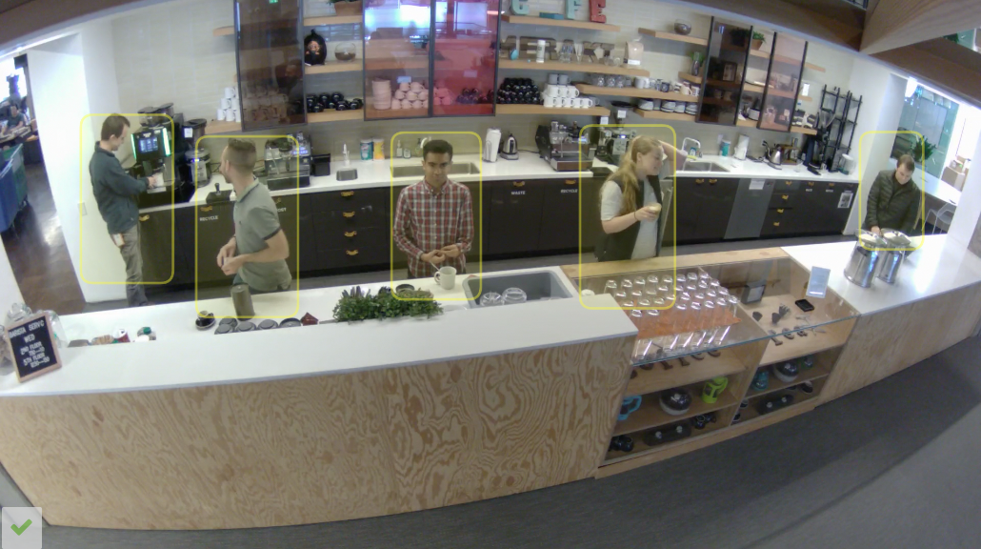
Physical Security Meets Business Intelligence
MOTION SEARCH
Automatically isolate key motion events using intelligent motion search metadata with a simple and robust timeline tool and overlay motion grid
Easily export important video segments and/or provide shareable URL links
Optimized to eliminate noise and false positives
MOTION HEAT MAPS
See relative motion in an area over time
Choose hour-by-hour or day-by-day view
Generated entirely from motion indexing metadata
Easily find the busiest minute or hour of any day or week
PERSON DETECTION
Identify what is a person, what is not a person, and perform historical people counting
MOTION BASED RETENTION
After 72 hours of continuous recording, discard footage with no motion, boosting retention to 30, 60, 90+ days.

Slide 34
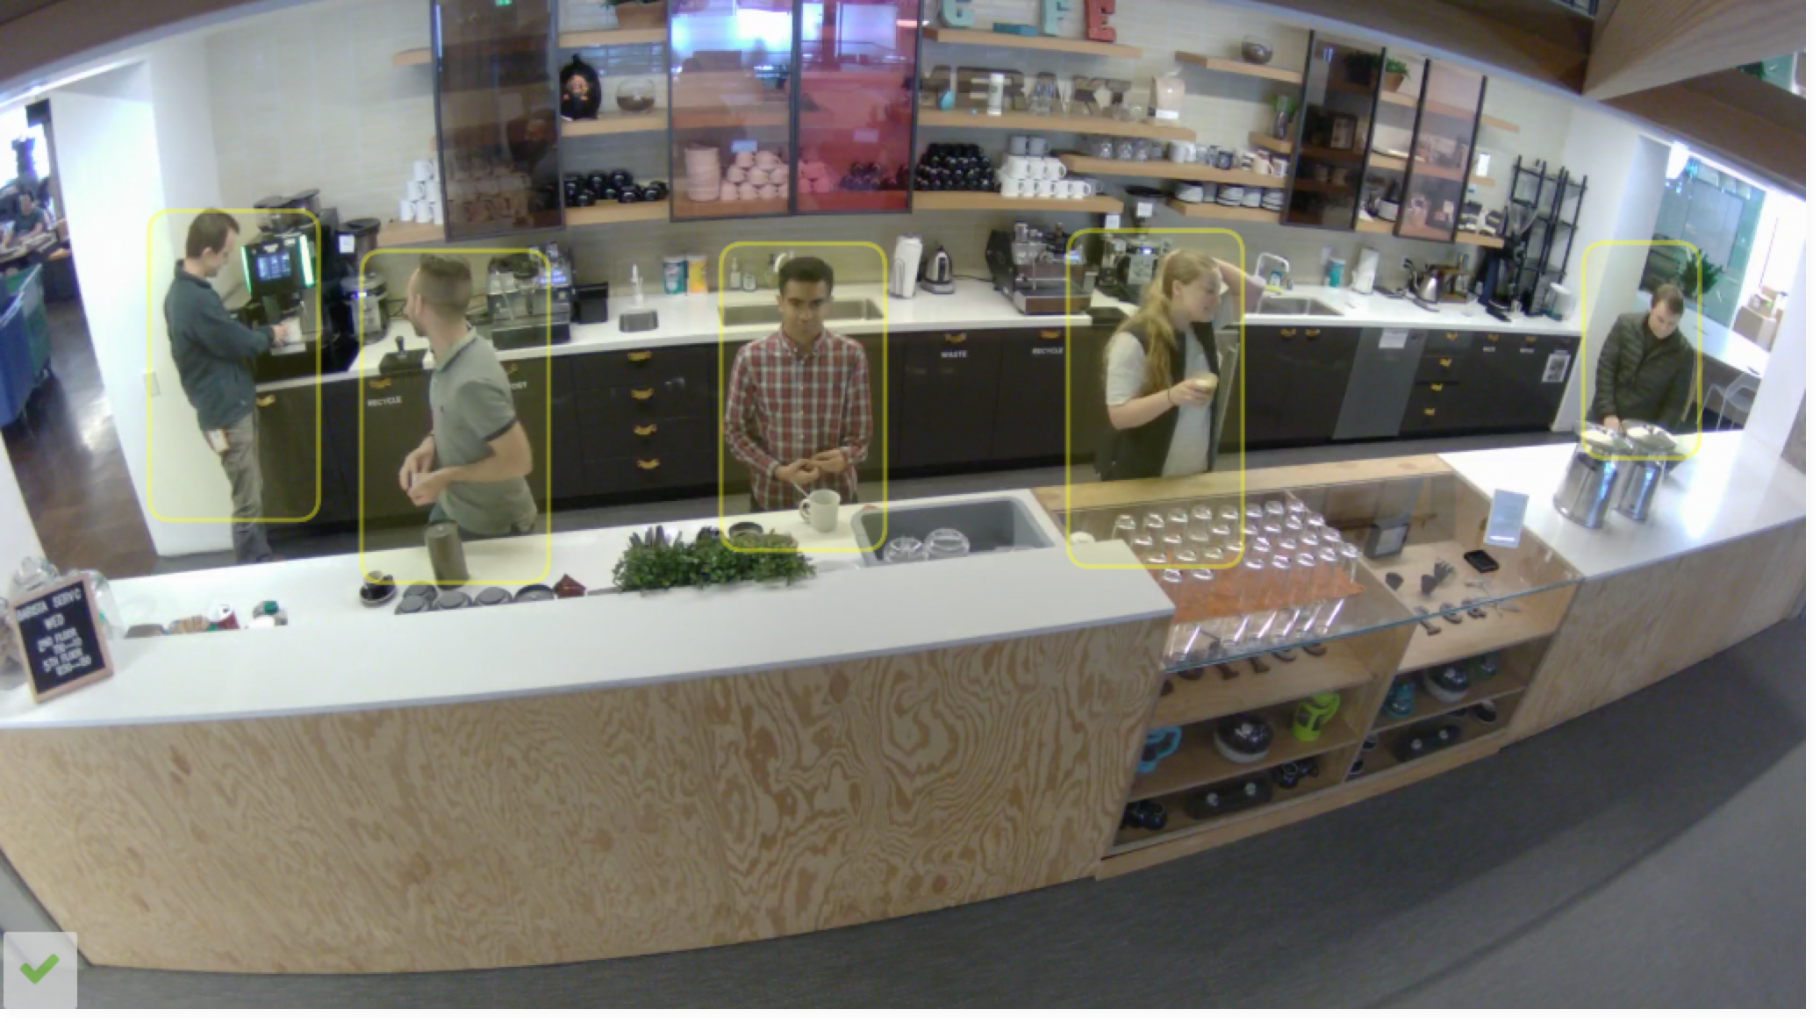
MV Person Detection & Counting
FUNCTIONALITY:
Anonymized person detection for business intelligence via machine learning with the camera as a sensor.
EXAMPLE USE CASE:
Better understand in-store customer behavior patterns and provide business insights over time.
Not facial recognition for privacy reasons. Will not track people. Just people/object detection.
- So by default there are no legal or privacy concerns about tracking individual people.
Cameras learn over time with respect to different heights, lighting conditions, movement, etc.
Cloud-based collective intelligence can then be leveraged across ALL MV12 deployments.
Notes:
Person detection = What is a person and what is NOT a person?
**NOT** facial recognition. We will not track people’s identities due to privacy concerns.
Example: If Joe enters the frame, the camera will detect a person. If Joe leaves the frame, then returns, he will be detected as a new person, not as “Joe.”

Slide 35
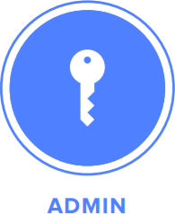
MV Role-based Access Control
Role-based granular access control
Define what any camera admin can or cannot do: prevent security staff from changing network settings, limit views to only selected cameras, restrict the export of video, allow live-only or historical footage, or provide emergency response teams instant access during an incident
Meraki cloud authentication architecture scales to organization of all sizes and supports Security Assertion Markup Language (SAML) integration for Single Sign-on

Slide 36
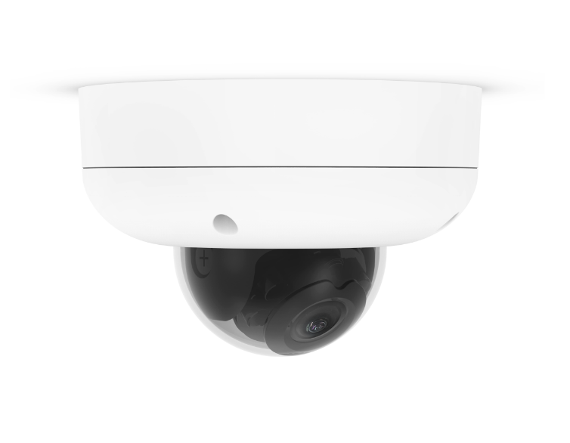
The Meraki MV Family
End-to-end encryption
Privacy windows
GDPR compliance
Outdoor Models IK10+ Rated
Original
MV21 & MV71
Motion Heat Maps
Person Detection
People Counting
Motion-based Retention
Motion-based Alerting
Wireless Capable
Audio Recording
Adaptive Bitrate Streaming
Timestamps on exports
Video Link Sharing
256GB Storage
PoE Powered
MV22 ^{NEW}
Indoor varifocal with advanced analytics
MV72 ^{NEW}
Outdoor varifocal with advanced analytics
MV12
Mini-dome with
advanced analytics
3 Year Warranty on all models
Notes:
Advanced analytics are now available across the portfolio
MV72 is first outdoor camera with advanced analytics capabilities in MV lineup
Varifocal = optical zoom (not PTZ)
MV72 is IK10+ rated for impact resistance, the highest rating possible

Slide 37
MV Cloud Archive
Optional add-on license for non-negotiable requirements for extended storage
Camera dual records to cloud and camera storage
Intuitive green-line / blue-line on recording timeline
Video is served up locally unless it only exists in the archive
Options for 90 or 180 days of 24/7 archive
Enabled by an optional, per camera license
Data stored in Azure (3 regions in NA, EU, Asia)
Works with all cameras including original MV21/71
Cloud Archive is not meant to be the primary means of video storage since it is more bandwidth-intensive, current max 1Mbps per camera.
Notes:
At FCS, Cloud archive restricts bandwidth to 1Mbps per camera, which equates to 1080p standard 8fps (1024Kbps).
With Cloud Archive enabled, motion based retention is automatically off.
720p standard quality 8fps = 535Kbps
720p enhanced quality 15fps = 765Kbps
1080p standard quality 8fps = 1024Kbps
1080p enhanced quality 15fps = 1562Kbps
1080p high quality 20fps = 3138Kbps

Slide 38
Introducing Meraki MV Sense
Smarter data to solve tougher business problems
HISTORICAL AGGREGATE
THIRD PARTY APPLICATIONS
REQUEST
How many were here at X time?
INPUT
CURRENT SNAPSHOT
Lots & lots of video data
REQUEST
How many people are here now?
MV COMPUTER VISION /
MACHINE LEARNING ALGORITHMS
REALTIME FEED
MV Sense is a new API for customers to interact with and build tools based on person detection analytics data collected by the cameras
SUBSCRIBE
Sub-second feed of people and location
Notes:
MV Sense is a new way for customers to interact with and build on top of the person detection data that comes out of MV12, MV22, and MV72 cameras.
The MV Sense API allows developers to access three types of rich data insights:
Historical aggregate: How many people were in a given area at a specified time, and where exactly were they in the frame?
Current snapshot: How many people are in a given area right now, and where exactly are they in the frame?
Real-time feed: A stream of the number of people and their exact location in a frame, pushed out in sub-second intervals
Each MV Sense license allows users to access person detection data produced by a camera (including location, time, and count) via a set of both RESTful and MQTT-based APIs.
Trigger a special in-store media display to begin playing if there are more than 10 people in close range of the screens
Understand wait times in grocery queues around the world
Quickly understand and alert emergency personnel if there are people left in a building during a fire drill or evacuation
Set off an alarm if the person count next to a dangerous piece of machinery in a manufacturing facility drops below the safe minimum
Lots more!
MQTT is a machine-to-machine IoT-based lightweight connectivity protocol. http://mqtt.org/
https://dashboard.meraki.com/api_docs#cameras

Slide 39
Meraki MI – Meraki Insight

Slide 40
MI Meraki Insight
Feature Highlights
Meraki Insight leverages the cloud to do the heavy lifting of application and protocol analytics, including external performance factors.
Provides excellent starting points, giving actionable information in Dashboard when troubleshooting an issue.
Visibility into external SaaS performance factors – ISP, WAN, Internet, Application servers (congestion, response times, errors, etc).
Performance Scores for Web-based applications based on client experience.
Autonomous detection of factors for poor application performance.
Nothing to install, the MX appliance is used as a collector to gather data.
Data is based on end-user HTTP/HTTPS data, so no need for synthetic probes.
Leverages the MX’s deep packet inspection – MI has no performance impact.
Licenses sized from small to extra-large, mapping to suitable MX models.
One MI license per network, not tied to any specific MX, deploy as few or as many as needed.

Slide 41
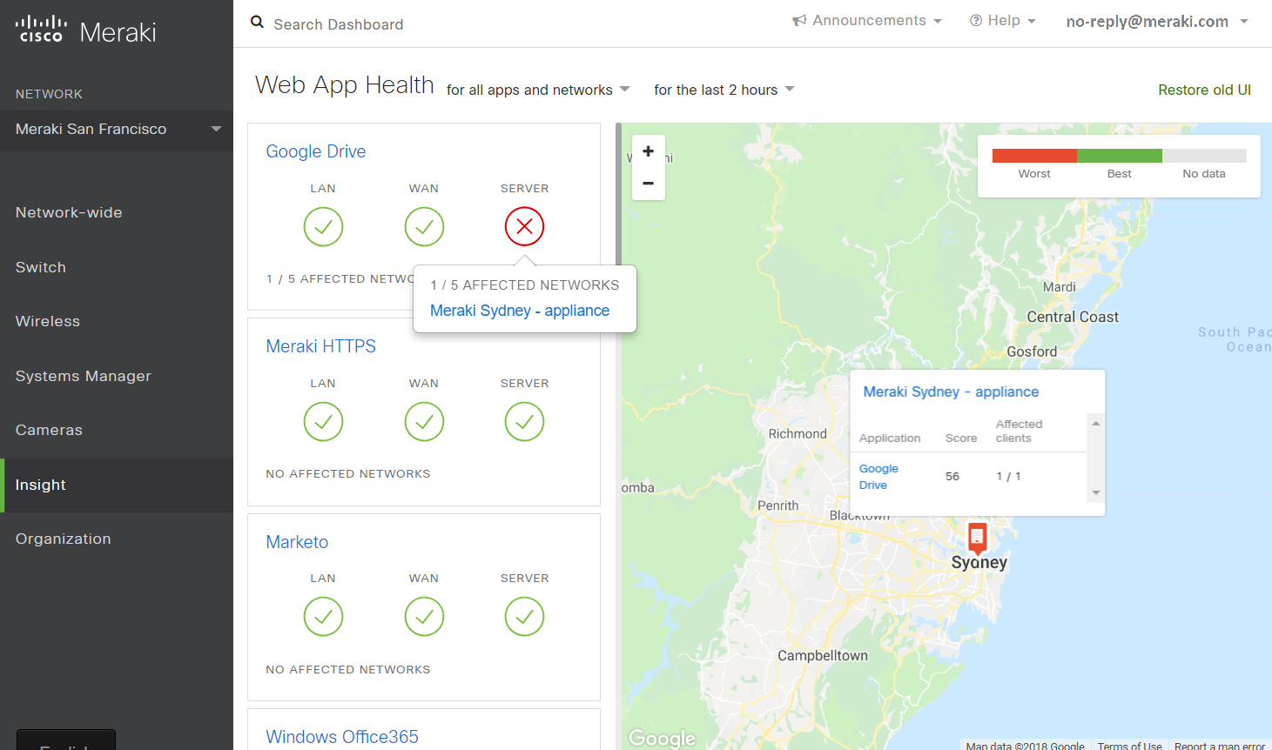

Slide 42
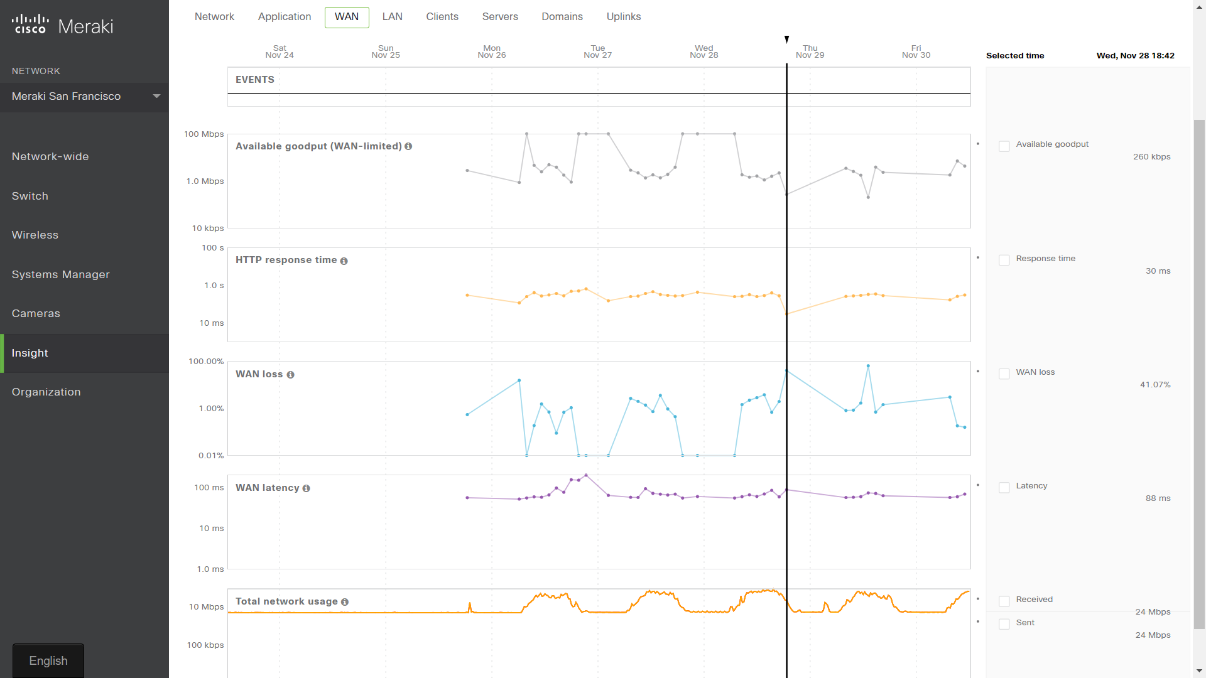

Slide 43
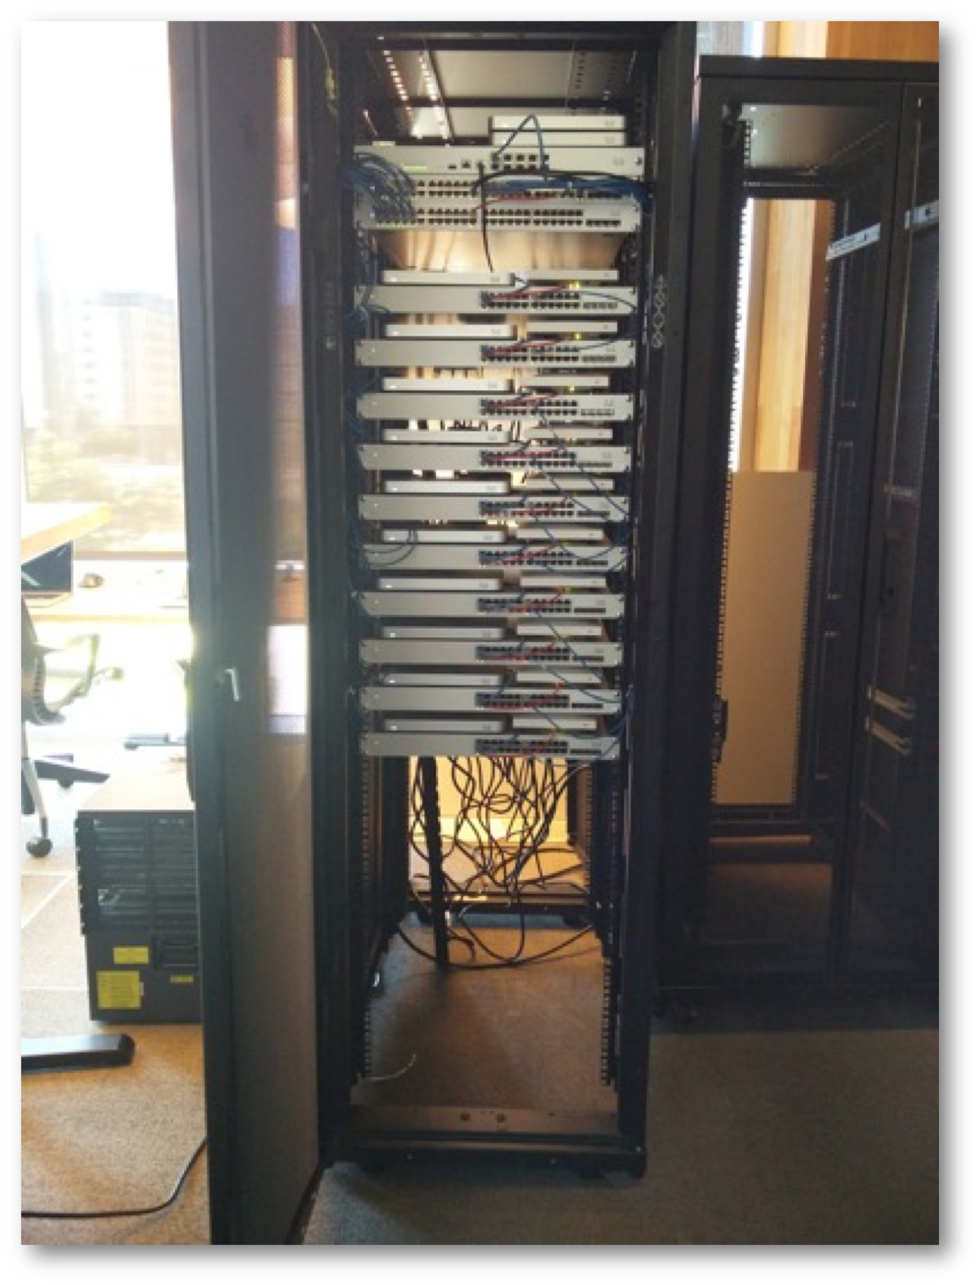
Hands-on Lab
Each of you will be responsible for configuring a #fullstack of Meraki gear for an individual “branch office”.
You’ll be configuring real gear in San Francisco via the Meraki Dashboard

Slide 44
More Cisco Meraki Info
Home Page - https://meraki.cisco.com/
All Products - https://meraki.cisco.com/products
List Price Calculator - https://meraki.cisco.com/buy/cost-calculator
Documentation - https://documentation.meraki.com/
Partner Website - https://meraki.cisco.com/partners/
Partner Portal - http://merakipartners.com/
Webinars - https://meraki.cisco.com/webinars
Data Sheets, Whitepapers, Solution Guides - https://meraki.cisco.com/library
YouTube Channel - https://www.youtube.com/user/milesmeraki
Official Blog - http://meraki.cisco.com/blog
Meraki Data Centers & Back-End - https://meraki.cisco.com/trust/
Developers - http://create.meraki.io/
Twitter - @Meraki
Linkedin - https://www.linkedin.com/company/cisco-meraki/

